Slide 1
Algorithms and Data Structures
Lecture XIV
Simonas Šaltenis
Nykredit Center for Database Research
Aalborg University
simas@cs.auc.dk

Slide 2
This Lecture
Introduction to computational geometry
  Points and lines in 2D space
  Line sweep technique
  Closest pair of points using divide-and-conquer

Slide 3
Computational Geometry
The term first appeared in the 70’s
Originally referred to computational aspects of solid/geometric modeling
Later as the field of algorithm design and analysis for discrete geometry
Algorithmic basis for many scientific & engineering disciplines
  GIS, robotics, computer graphics, computer vision, CAD/CAM, VLSI design, etc.

Slide 4
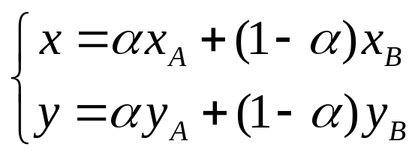
Geometric Objects in Plane
Point: defined by a pair of coordinates (x,y)
Segment: portion of a straight line between two points – their convex combinaiton
Polygon: a circular sequence of points (vertices) and segments (edges) between them
A
B

Slide 5
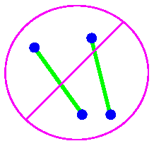
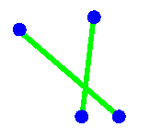
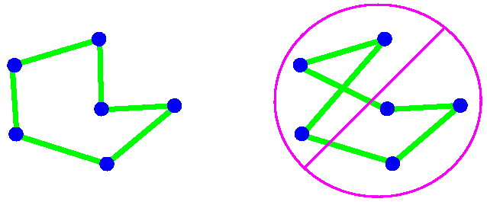
Some Geomtric Problems
Segment intersection: Given two segments, do they intersect?
Simple closed path: Given a set of points, find a non-intersecting polygon with vertices on the points

Slide 6
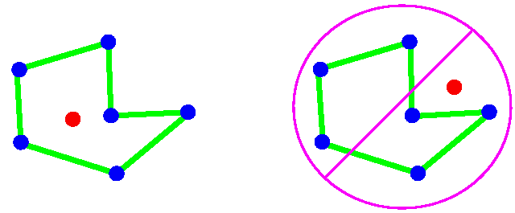
Some Geomtric Problems (2)
Inclusion in polygon: Is a point inside or outside a polygon?

Slide 7
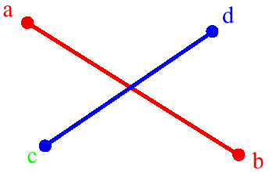
Segment Intersection
Test whether segments (a,b) and (c,d) intersect. How do we do it?
We could start by writing down the equations of the lines through the segments, then test whether the lines intersect, then ...
An alternative (and safer) approach is based in the notion of orientation of an ordered triplet of points in the plane

Slide 8
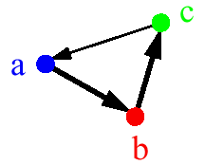
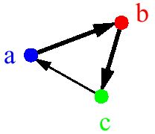

Orientation in the Plane
The orientation of an ordered triplet of points in the plane can be
  counterclockwise (left turn)
  clockwise (right turn)
  collinear (no turn)
counterclockwise (left turn)
clockwise
(right turn)
collinear (no turn)

Slide 9
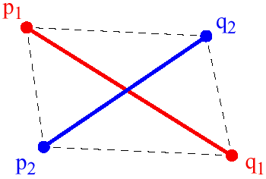
Intersection and Orientation
Two segments (p₁,q₁) and (p₂,q₂) intersect if and only if one of the following two conditions is satisfied
General case:
  (p₁,q₁,p₂) and (p₁,q₁,q₂) have different orientations and
  (p₂,q₂,p₁) and (p₂,q₂,q₁) have different orientations
Special case
  (p₁,q₁,p₂), (p₁,q₁,q₂), (p₂,q₂,p₁), and
  (p₂,q₂,q₁) are all collinear and
  the x-projections of (p₁,q₁) and (p₂,q₂) intersect
  the y-projections of (p₁,q₁) and (p₂,q₂) intersect

Slide 10
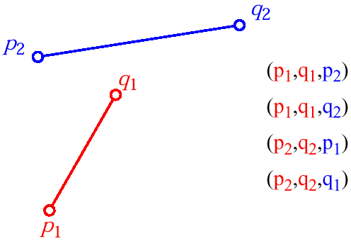
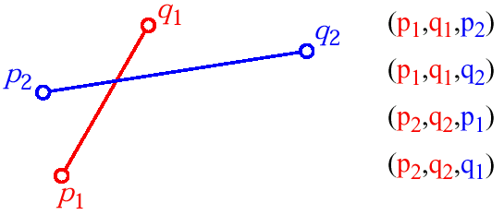
Orientation Examples
General case:
  (p₁,q₁,p₂) and (p₁,q₁,q₂) have different orientations and
  (p₂,q₂,p₁) and (p₂,q₂,q₁) have different orientations

Slide 11
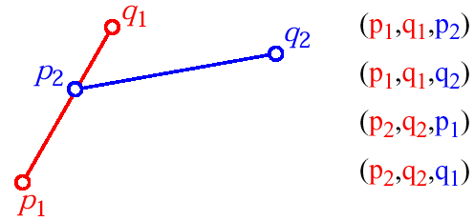
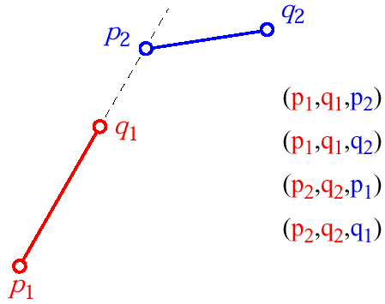
Orientation Examples (2)

Slide 12
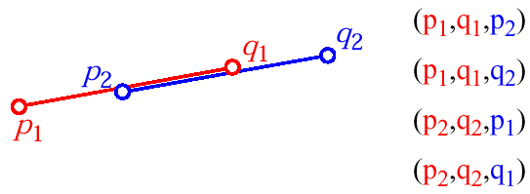
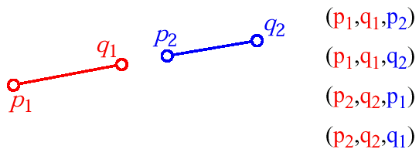
Orientation Examples (3)
Special case
  (p₁,q₁,p₂), (p₁,q₁,q₂), (p₂,q₂,p₁), and
  (p₂,q₂,q₁) are all collinear and
  the x-projections of (p₁,q₁) and (p₂,q₂) intersect
  the y-projections of (p₁,q₁) and (p₂,q₂) intersect

Slide 13
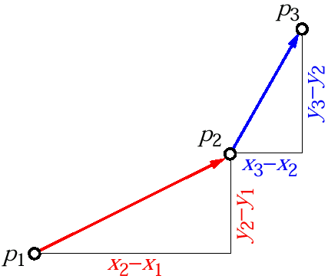
Computing the Orientation
slope of segment (p₁ ,p₂ ): σ = (y₂-y₁)/(x₂-x₁)
slope of segment (p₂ ,p₃ ): τ = (y₃-y₂)/(x₃-x₂)
Orientation test
  counterclockwise (left turn): σ < τ
  clockwise (right turn): σ > τ
  collinear (no turn): σ = τ

Slide 14
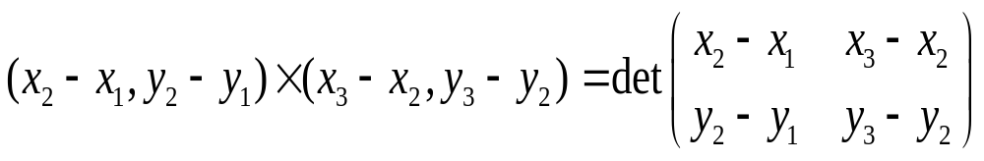
Computing the Orientation (2)
The orientation depends on whether the following expression is positive, negative, or 0
(y₂-y₁)(x₃-x₂) - (y₃-y₂)(x₂-x₁) = ?
This is a cross product of two vectors

Slide 15
Determining Intersections
Given a set of n segments, we want to determine whether any two line segments intersect
A brute force approach would take O(n²) time (testing each with every other segment for intersection)

Slide 16
Determining Intersections (2)
It can be done faster by using a powerfull comp. geometry technique, called plane-sweeping. Two sets of data are maintained:
  sweep-line status: the set of segments intersecting the sweep line l
  event-point schedule: where updates to l are required
event point
l : sweep line

Slide 17
Plane Sweeping Algorithm
Each segment end point is an event point
At an event point, update the status of the sweep line & perform intersection tests
  left end point: a new segment is added to the status of l and it’s tested against the rest
  right end point: it’s deleted from the status of l
Only testing pairs of segments for which there is a horizontal line that intersects both segments
This might be not good enough. It may still be inefficient, O(n²) for some cases

Slide 18
Plane Sweep Algorithm (2)
To include the idea of being close in the horizontal direction, only test segments that are adjacent in the vertical direction
Only test a segment with the ones above and below (predecessor and successor, rings a bell…)
  the ”above-below” relationship among segments does not change unless there is an intersection
New “status”: ordered sequence of segments

Slide 19
Plane Sweeping Algorithm (3)
b
d
c
e
a
a
ba
b
ca
b
ca
d
b
c
d
c
d
e
c
d
e
d
e

Slide 20
Pseudo Code
AnySegmentsIntersect(S)
01 T ← ∅
02 sort the end points of the segments in S from left to right, breaking ties by putting points with lower y-coords first
03 for each point p in the sorted list of end points do
04 if p is the left end point of a segment s then
05 Insert(T,s)
06 if (Above(T,s) exists and intersects s) or (Below(T,s) exists and intersects s) then
07 return TRUE
08 if p is the right end point of a segment s then
09 if both Above(T,s) and Below(T,s) exist and Above(T,s) intersects Below(T,s) then
10 return TRUE
11 Delete(T,s)
12 return FALSE

Slide 21
Implementing Event Queue
Define an order on event points
Store the event points in a priority queue
  both insertion or deletion takes O(log n) time, where n is the number of events, and fetching minimum – O(1)
  For our algorithm sorted array is enough, because the set of events does not change.
Maintain the status of l using a binary search treeT (e.g., red-black tree)
  the up-to-down order of segments on the line l <=> the left-to-right order of in-order traversal of T
  each update and search takes O(log n)

Slide 22
Status and Structure
S_{i}
S_{j}
S_{k}
S_{l}
S_{m}
l
S_{l}
S_{j}
T
S_{m}
S_{i}
S_{k}

Slide 23
Running Time
Sorting the segments takes O(n log n) time
The loop is executed once for every end point (2n) taking each time O(log n) time (e.g., red-black tree operation)
The total running time is O(n log n)

Slide 24
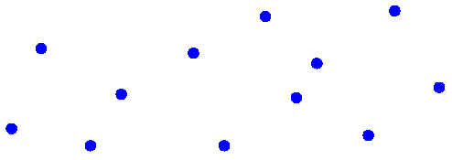
Closest Pair
Given a set P of N points, find p,q ∈ P, such that the distance d(p, q) is minimum
Algorithms for determining the closest pair:
  Brute Force O(n²)
  Divide and Conquer O(n log n)
  Sweep-Line O(n log n)

Slide 25
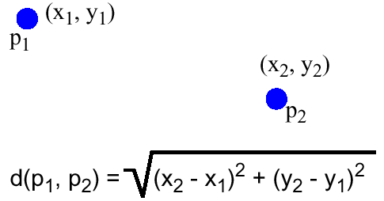
Brute Force
Compute all the distances d(p,q) and select the minimum distance
Running time O(n²)

Slide 26
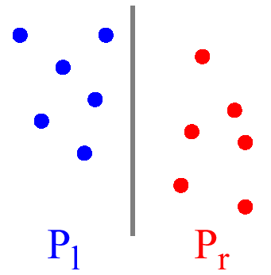
Divide and Conquer
Sort points on the x-coordinate and divide them in half
Closest pair is either in one of the halves or has a member in each half

Slide 27
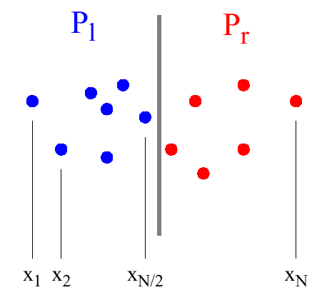
Divide and Conquer (2)
Phase 1: Sort the points by their x-coordinate
p₁ p₂ ... p_{n/2} ... p_{n/2+1} ... p_{n}

Slide 28
Divide and Conquer (3)
Phase 2: Recursively compute closest pairs and minimum distances,
  d_{l} , d_{r} in
  P_{l} = {p₁, p₂, ... , p_{n/2} }
  P_{r} = {p_{n/2+1}, ... , p_{n} }
Find the closest pair and closest distance in central strip of width 2d, where
  d = min(d_{l}, d_{r} )
in other words...

Slide 29
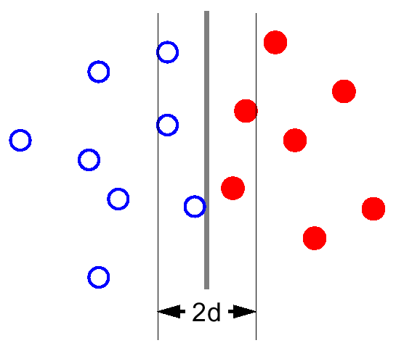
Divide and Conquer (4)
Find the closest ( , ) pair in a strip of width 2d, knowing that no ( , ) or ( , ) pair is closer than d

Slide 30
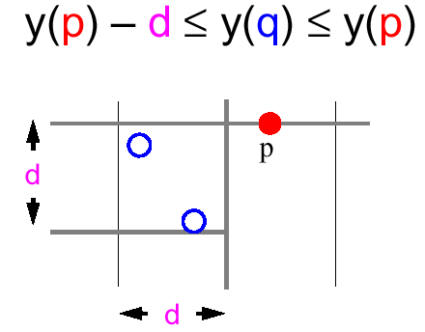
Combining Two Solutions
For each point p in the strip, check distances d(p, q), where p and q are of different colors and:
There are no more than four such points!

Slide 31
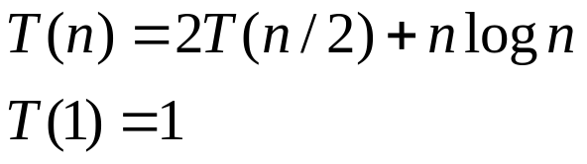

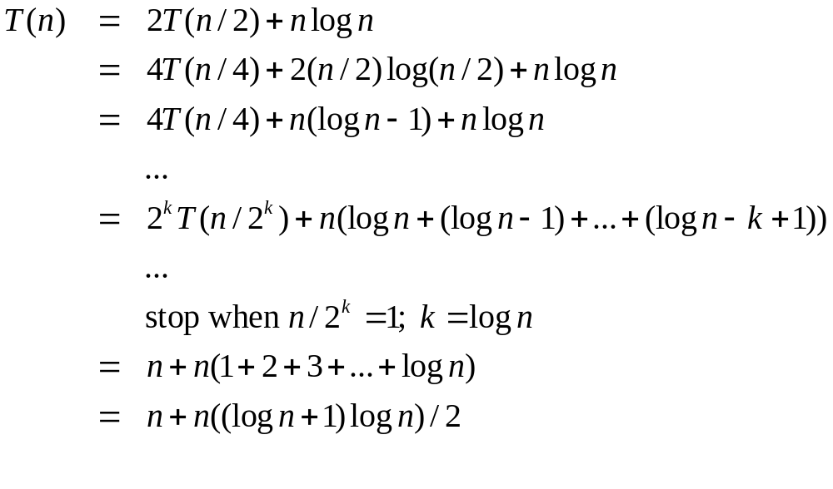
Running Time
Sorting by the y-coordinate at each conquering step yields the following recurrence

Slide 32
Improved Algorithm
The idea: Sort all the points by x and y coordinate once
Before recursive calls, partition the sorted lists into two sorted sublists for the left and right halves
When combining, run through the y-sorted list once and select all points that are in a 2d strip around l.

Slide 33
Running Time
Phase 1:
  Sort by x and y coordinate:
  O(n log n)
Phase 2:
  Partition: O(n)
  Recur: 2T(n/2)
  Combine: O(n)
T(n) = 2 T(n/2) + n = O(n log n)
Total Time: O(n log n)

Slide 34
Next Lecture
Introduction to complexity classes
  Tractable/intractable problems
  NP-Completeness

